Slide 1
Cerebellum
Mustafa Al-Badran
CABM FIBMS
College of Medicine\ University of Basrah

Slide 2
Objectives
What is cerebellum
The Functions of cerebellum
Anatomical areas of cerebellum
Input (afferent) Pathways to the Cerebellum
Output (Efferent) Signals from the Cerebellum
Functional divisions of Cerebellum
University of Basrah-College of Medicine-Physiology Department
1

Slide 3
The cerebellum receives information from the sensory systems, the spinal cord, and other parts of the brain and then regulates motor movements
The cerebellum coordinates voluntary movements such as posture, balance, coordination, and speech
It has long been called a silent area of the brain, principally because electrical excitation of the cerebellum does not cause any conscious sensation and rarely causes any motor movement
University of Basrah-College of Medicine-Physiology Department
2

Slide 4
Why the cerebellum is very important despite that it has no direct ability to cause muscle contraction?
It helps sequence the motor activities
Monitors and makes corrective adjustments in the body’s motor activities while they are being executed
University of Basrah-College of Medicine-Physiology Department
3

Slide 5
Anatomical and Functional areas of cerebellum
The cerebellum is divided into three lobes by two deep fissures
The Anterior lobe
The Posterior lobe
The Flocculonodular lobe
University of Basrah-College of Medicine-Physiology Department
4

Slide 6
In the center of cerebellum, narrow band separated from remainder by smaller grooves called "vermis"
In the vermis, most cerebellar control functions of muscle movements of axial body, neck, shoulders, and hips are located
On each side of vermis, there is large protruding "cerebellar hemisphere"
Each hemisphere is divided into an "intermediate zone" and "lateral zone“
University of Basrah-College of Medicine-Physiology Department
6

Slide 7
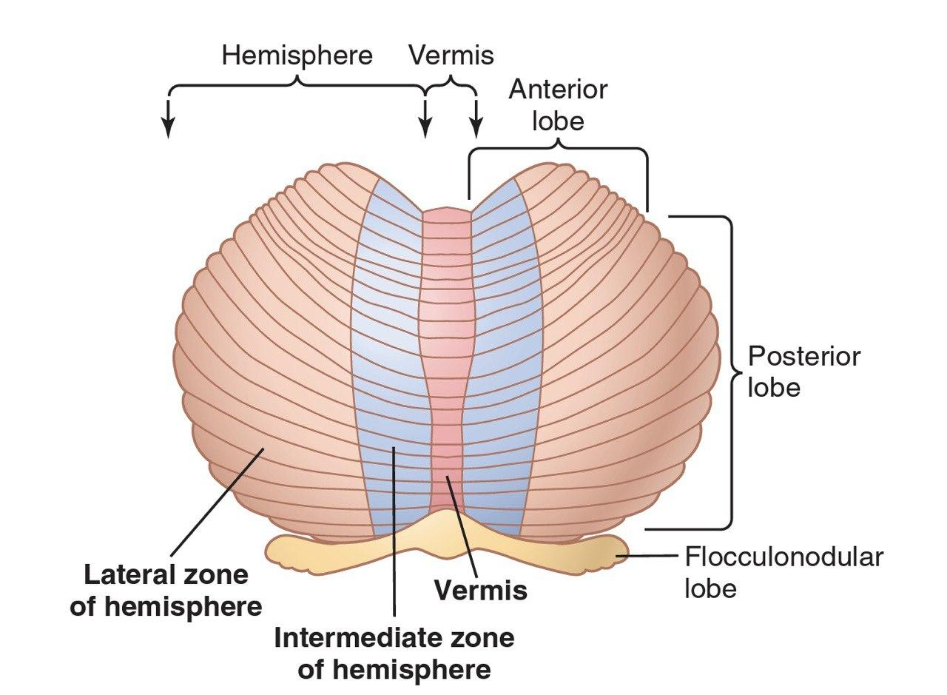
University of Basrah-College of Medicine-Physiology Department
5

Slide 8
The intermediate Zone
Concerned with controlling muscle contractions in distal portions of upper and lower limbs (hands, fingers, feet, and toes)
The Lateral Zone
This area joins with cerebral cortex in overall planning of sequential motor movements
Without this zone, most discrete motor activities of body lose their appropriate timing and sequencing → become in coordinated
University of Basrah-College of Medicine-Physiology Department
7

Slide 9
Input (Afferent) Pathways to the Cerebellum
From other parts of brain
Motor and Somatosensory cortices through corticopontocerebellar pathway to lateral divisions of cerebellar hemisphere on opposite side
Brainstem through
Olivocerebellar tract
Vestibulocerebellar tract
Reticulocerebellar tract
University of Basrah-College of Medicine-Physiology Department
8

Slide 10
From the periphery
Dorsal Spinocerebellar tract
Transmit input signals from
Muscle spindles
Golgi tendon organs, large tactile receptors of skin, and joint receptors
University of Basrah-College of Medicine-Physiology Department
9
Notes:
These signals apprises cerebellum of momentary status about:
Muscle contraction
Degree of tension on muscle tendon
Positions and rates of movements of the body parts
Forces acting on the body surface

Slide 11
These signals explains cerebellum of momentary status about
Muscle contraction
Degree of tension on muscle tendon
Positions and rates of movements of the body parts
Forces acting on the body surface
University of Basrah-College of Medicine-Physiology Department
10

Slide 12
Ventral Spinocerebellar tract
Enter same areas of cerebellum through superior cerebellar peduncle and terminate in both sides of cerebellum
These fibers tell the cerebellum what motor signals are arrived at the anterior horns
University of Basrah-College of Medicine-Physiology Department
11

Slide 14
Functional units of cerebellar cortex
Three layers form the functional units of cerebellum
External molecular layer
Purkinje cell layer(One-cell thickness) →Inhibitory
Internal granular layer →Excitatory
University of Basrah-College of Medicine-Physiology Department
12

Slide 15
Output (Efferent) Signals from the Cerebellum
Three cerebellar nuclei
Dentate Nucleus
Interposed Nucleus
Fastigial Nucleus
Globose nucleus
Emboliform nucleus
University of Basrah-College of Medicine-Physiology Department
14

Slide 16
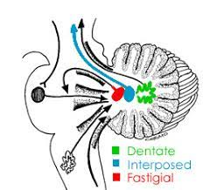
University of Basrah-College of Medicine-Physiology Department
13

Slide 17
Output signals leave deep nuclei of cerebellum and distributed to other parts of brain through
Pathway originate in the vermis
Through fastigial nuclei into pons and medulla oblongata of brainstem
Function to:
Control equilibrium in association with vestibular apparatus
Control postural attitudes of body in association with reticular formation
University of Basrah-College of Medicine-Physiology Department
15

Slide 19
Pathway originate in intermediate zone pass
Through interposal nuclei to Ventrolateral & Ventroanterior nuclei of thalamus  to cerebral cortex  Several midline structures of thalamus  to basal ganglia  to Red nucleus and Reticular formation of brainstem
Functions to coordinate reciprocal contractions of agonist and antagonist muscles in hands, fingers, and thumb
University of Basrah-College of Medicine-Physiology Department
16

Slide 21
Cerebellum Functionally divided overall in to
1. The vestibulocerebellum
It provides neural circuits for most of the body’s equilibrium movements (Balance)
2. The spinocerebellum
It provides the circuits for coordinating movements of the distal portions of the limbs, especially the hands and fingers (Manage Stance and gait)
3. The cerebrocerebellum
Plan sequential voluntary body and limb movements (Smoothing the movements )
University of Basrah-College of Medicine-Physiology Department
17

Slide 22
Recap
1. Cerebellum receives information from the sensory systems, the spinal cord, and other parts of the brain
2. It regulates, coordinates voluntary movements , posture, balance, coordination, and speech
3. It helps sequence, and monitor the motor activities
4. Anatomically, divided into :the anterior, posterior and flocculonodular lobes
5. Receives
Input from brain (Motor and somatosensory, Brainstem )
From the periphery
6. Functional units
7. Output Signals from the Cerebellum
8. Functional divisions
19

Slide 23
Thank You

